Slide 1


Instructor/Advisor Training
Author’s Name • Date

Slide 2

The Star Thrower
A man saw a boy collecting starfish and gently throwing them into the ocean.
“The tide is going out. If I don’t throw them back, they’ll die,” explained the boy.
“But look,” the man said. “There are miles and miles of beach and hundreds of starfish!”
The boy picked up another starfish, threw it into the surf, smiled at the man, and said:
“I made a difference for that one.”
Adapted from a story by Loren Eiseley
Notes:
Talk Track: Does anyone know why it’s called Starfish?
Our mission is embodied in the story of the Star Thrower; mirrors our philosophy of helping each student succeed. Everyone here probably has their own starfish story.
Tips: Leave this up while everyone is assembling; you don’t have to tell the story, except to say that it is the reason for our name.

Slide 3

Who’s in the room?
Please introduce yourself by sharing your name, your role at the institution, and your level of experience with Starfish.
4

Slide 4
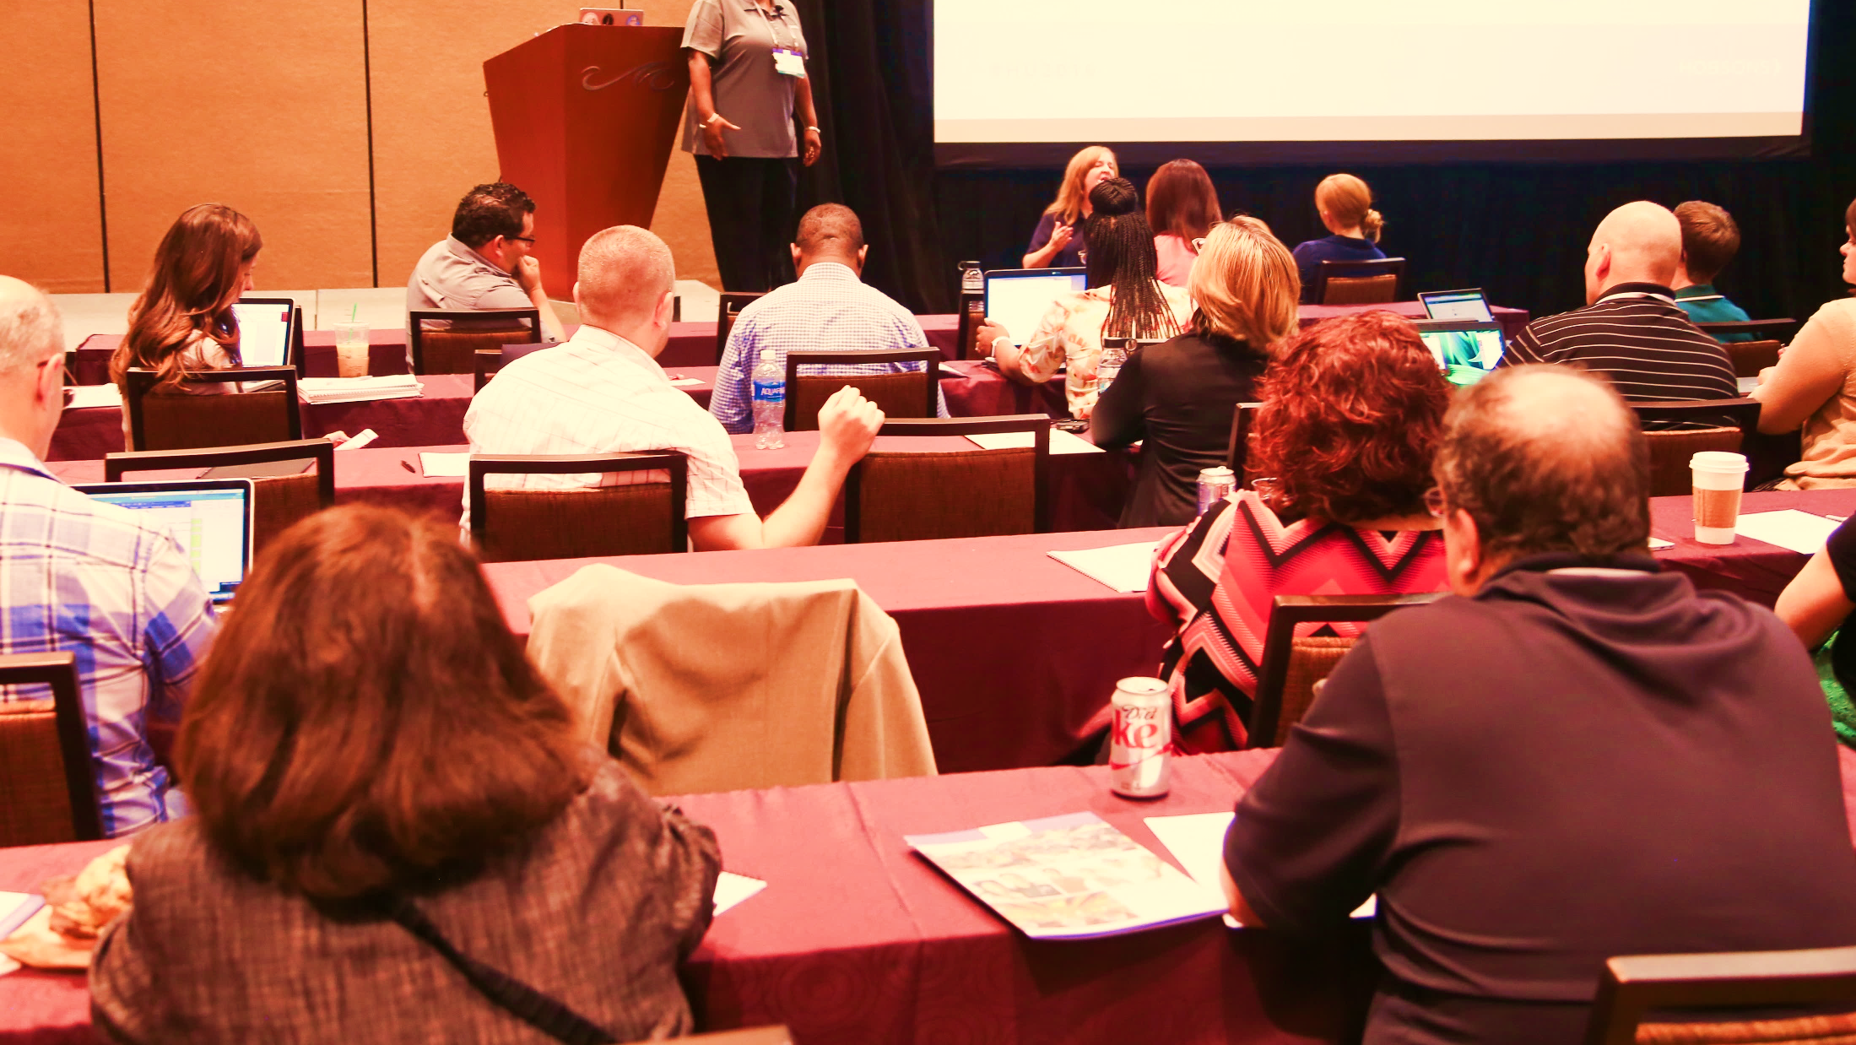
Objectives
In this training you will learn:
How Starfish supports our retention initiatives
What role you play in this initiative
How to login and navigate Starfish
How instructors and advisors will raise and manage alerts
Where to go for resources/support
Notes:
NOTE: personalize this to be in line with your goals and objectives
Questions are encouraged, both regarding the processes/workflow for the institution and for Starfish.
Since we are in the process of configuring Starfish, there are still some decisions being made, so your feedback is important to the process.
Also consider as we go through the materials how they should be modified for your own use with the instructors and advisors going forward.

Slide 5
Training Agenda
Our Team
Our Initiative
Measuring Success
Our System
Overview/Benefits
Expectations & Workflow
Hands on Tour
Wrap Up
Resources & Support
Who’s Involved

Slide 6

Our Team

Slide 7
Our Starfish Implementation Team
Executive Sponsor:
Functional Lead:
Technical Lead:
Faculty Liaison:
Other members of our team:
Notes:
Identify team members and stress that their input is critical in the process. Their involvement ensures that the system will be useful as it is being built WITH, rather than FOR them.

Slide 8
Our Initiative

Slide 9
How Will We Measure Success?
Short Term Goals
Adoption of Starfish
Increased office proficiencies
Longer Term Goals
Year-to-year persistence
Engagement
Successful course completion
Certificate/Degree Attainment
Notes:
Introduce the initiative that is underway of which Starfish is a supporting tool.
Why is this important (why did we take this on)?
-What do we hope to get out of this investment in Starfish, and in our overall solution?
How does this impact the audience’s life (short/longer term)?
The impact of Starfish begins with its users…Students, Faculty, and Staff. It’s a tool that can only be useful if it’s used properly
Long term goals are often the byproduct of successful short term goals. It takes time and sustained effort and commitment to see results.

Slide 10
Our Starfish System

Slide 11

Key Benefits for
Faculty & Staff
Quickly provide feedback on students and help connect them with services
Access useful information on your students on one screen
Easily share your concerns with the right people at the right time
Provide positive reinforcement of successful behaviors
Communicate with students individually or in groups
Easily record outcomes on student meetings
Understand predicted retention and how to address risk
Socialize the breadth of available interventions available on campus
Notes:
Review Benefits and ask participants to identify which one resonates most with them.

Slide 12
Specific Expectations
Faculty
Students
Everyone
Advisors/Coaches
Notify your class that you’re using Starfish
Raise flags when appropriate
Submit progress surveys when available
Include specifics and next steps for student when applicable
Access students in Starfish
Record follow up actions in Starfish:
Add notes
Schedule appointments/record outcomes
Clear flags
Close the loop
Respond to email notifications when flagged
Contact appropriate support office(s)
Follow through with Instructor and/or support staff recommendations
Complete your Starfish profile
Explore Starfish system and respond to user feedback surveys as requested
Refer to training materials provided
Notes:
Modify this to reflect the expectations of each of you user groups.

Slide 13
Workflow

Slide 14





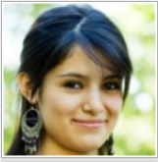







Early Alert Workflow
Instructor
Student
Advisor
Notes:
This slide provides a great opportunity to tell a story and walk your users through a typical Early Alert workflow. The animations allow you to talk through steps as they occur:
“Professor Maitz” is concerned about his student, “Rachel” as she hasn’t been coming to class
He goes into Starfish and raises an attendance flag (via progress survey or his students list)
This generates notifications to both Rachel and her academic Advisor, “Yasmin Gold”
Yasmin reaches out to Rachel regarding the flag
The two of them discuss Rachel’s attendance habit's and Yasmin gives her some actions to take to remedy the situation (specific actions or referral to an office/department
Yasmin documents the results of her outreach in Starfish
Now that she and Rachel have adequately addressed Professor Maitz’s concerns, she clears the flag and “Closes the Loop”, by informing him Rachel’s intended steps toward remediation

Slide 15
Our Tracking Items
Tracking Item Name | Raise this when your student(s) is/are/has: | What will happen when raised
 |  | Email | Outreach
Attendance Concern Flag | not attending class regularly | X
In Danger of Failing Flag | in jeopardy of failing the class | X | X
Non Attendance/No Show Flag | never attended your class | X | X
Recommendation to Withdraw Flag | unable to successfully complete the course (prior to withdrawal date) | X | X
Missing/Late Assignments | has outstanding coursework | X
Kudos | doing well in the course | X
15
Notes:
Insert your selected tracking items (could include referrals and to-do’s).
Let’s stop and talk about the specific flags that we will use this coming term, as well as the anticipated workflow for each of these flags (for the audience).
- Guidelines for when to raise each item listed
- Existing policies that come into play
- Responding to a raised flag on a student (refer back to Expectations slide)

Slide 16
Hands-On Tour: Let’s dive in!
Notes:
The next set of slides are meant to be used as a suggested flow of a hands-on tour of the system.
Recommendation: Login to Starfish and show this flow live in the system. Use slides/screenshots as backup if you cannot log in to the system.

Slide 17
Login to Starfish
[Insert instructions/screenshots on how and where to login to Starfish]
Notes:
Provide details about how /where they login, what their usernames are etc. If participants are able, they should log in and follow along

Slide 18
Hands-On Tour Agenda
Your View
Homepage
Progress Survey
Students List (filter)
Student Folder - Info, Courses
Close the Loop
Add Office Hours
Appointment Outcomes
Profile – Institutional, Appointment Preferences, Email Notifications
Student View
Student Homepage
My Success Network
Notes:
We’ll start with the staff and faculty view, then take a look at the student’s view.

Slide 19
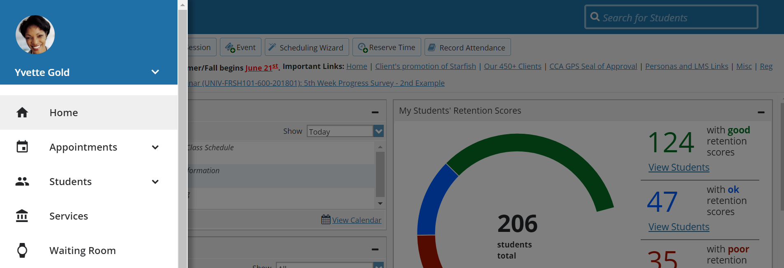
Starfish Navigation
Notes:
Click on any top Navigation item to go to the main page for that section, or click the down arrow associated with the top level item to bring up a selection of specific options. You can also use the quick search box to find a student and go directly to their student folder.
This top navigation remains available wherever you move within Starfish.

Slide 20
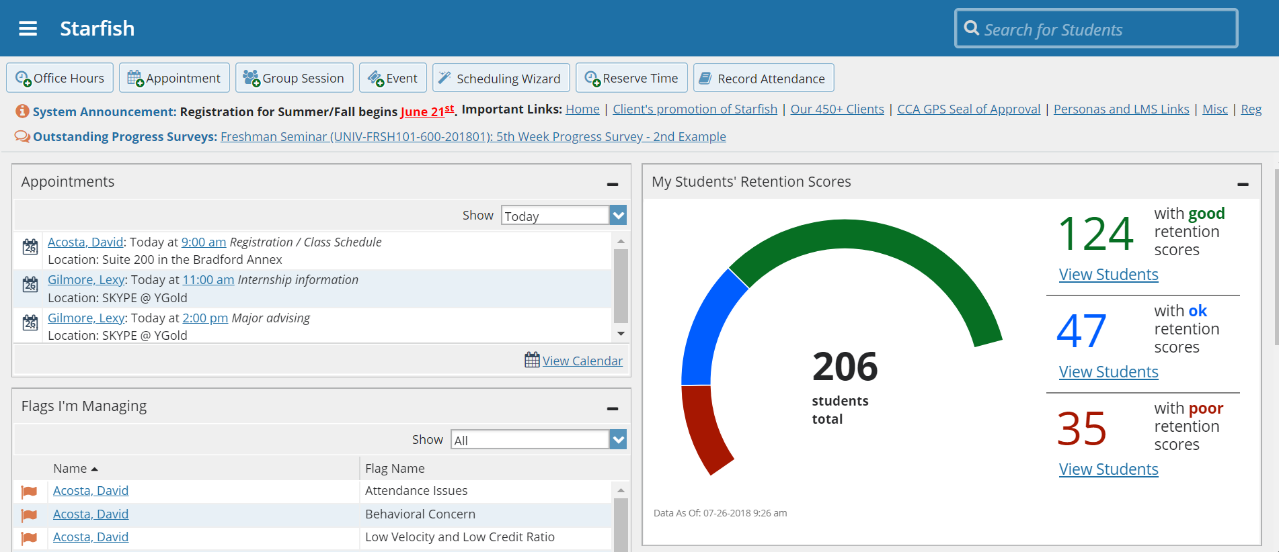
Starfish Homepage
Notes:
After your first time logging in, when you sign in to Starfish you will be on the homepage. The panels you see on your dashboard will be somewhat dependent on the roles you have in Starfish.
You can designate a different page as your Homepage in your profile. Walk users through the various sections

Slide 21
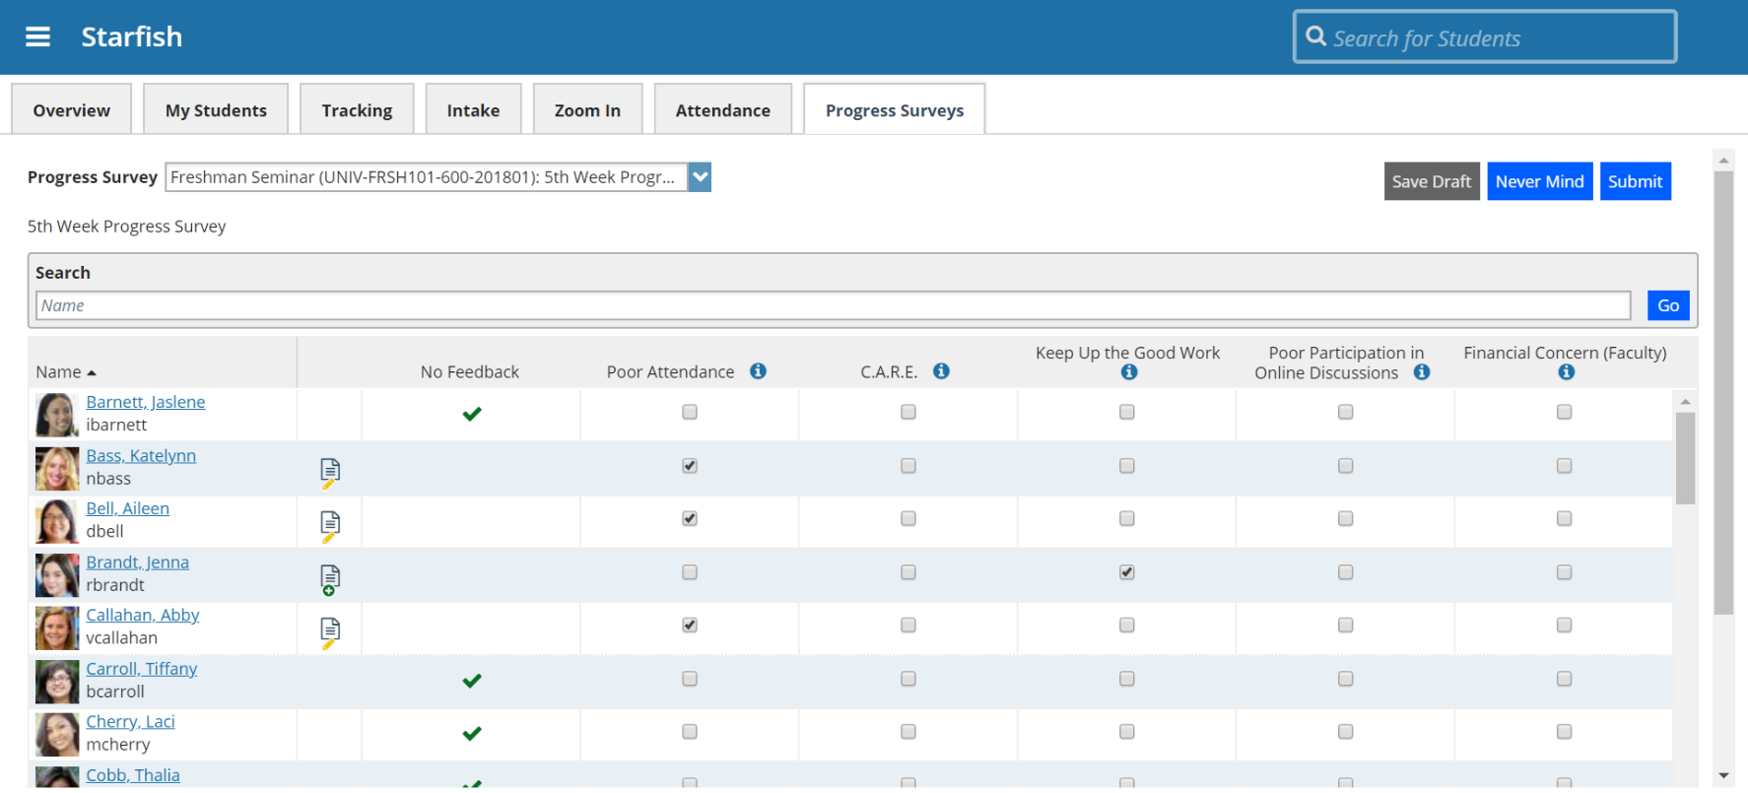
Respond to a Progress Survey
Notes:
When the instructor selects the survey link on the homepage, they’ll come to the progress survey tab within the Students section.
They can also access other surveys from this page by selecting the course from the Survey tab.
For each student on the survey, the instructor can either leave the default of ‘No Feedback’ or click on any of the flags listed.
If the flag requires comments, the comments box will be displayed. Or to add a comment on any flag you raise, click the note icon associated with the student.
When the instructor is finished they click submit. If they need more time, they can click Save Draft and return later. NOTE: Until the survey is submitted, no flags will be raised.

Slide 22
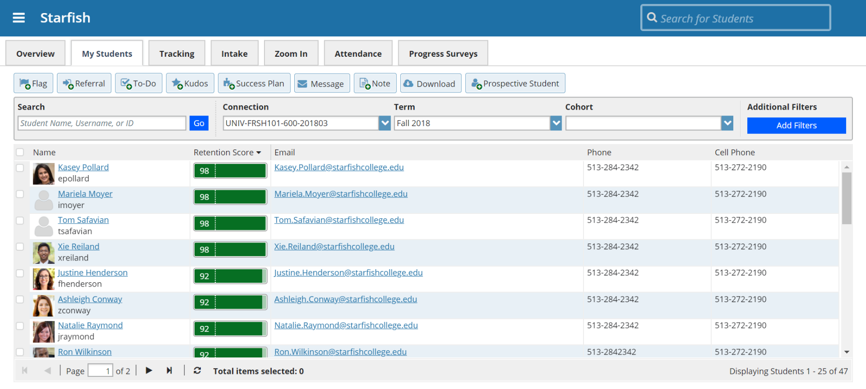
My Students List
Notes:
Access your students by selecting the ‘My Students’ tab. Be sure to check your “Connection” and “Term” settings. Reminder: You can search a student by using the search bar at the top.
Use the radial dials to the left of your list to select multiple students for flags, kudos, etc. *Separate notifications will be sent to each student
Select Add Filters option to isolate particular groups of students based on your criteria (ie-course sections, attributes, cohorts, etc.) then take actions such as raise a flag, add a success plan, or download the list to Excel.

Slide 23
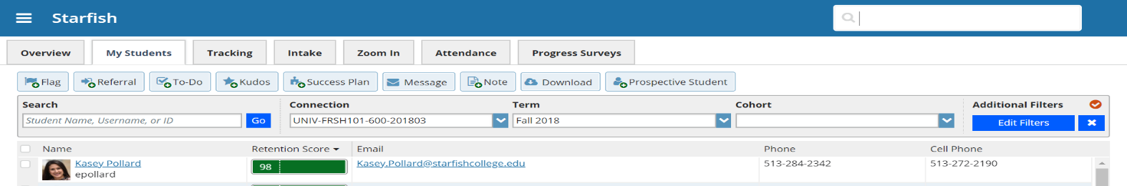
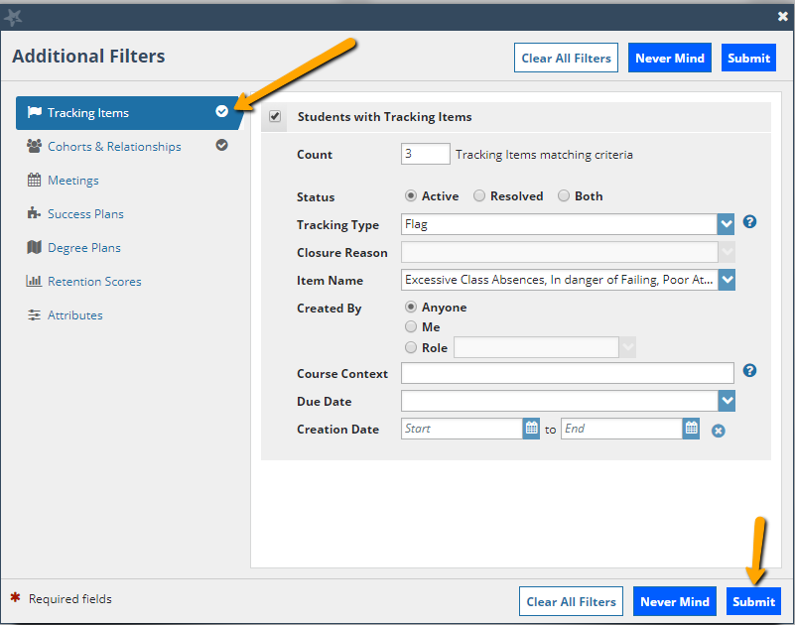
Filtering the Students List
Notes:
Starfish will indicate when filters are set with an icon. Click the X to remove all filters.
Click Add Filters to open the Additional Filters window. You may filter your students list by tracking items, cohorts and relationships, meetings, plans, scores or attributes, or a combination of these factors. Then click Submit.

Slide 24
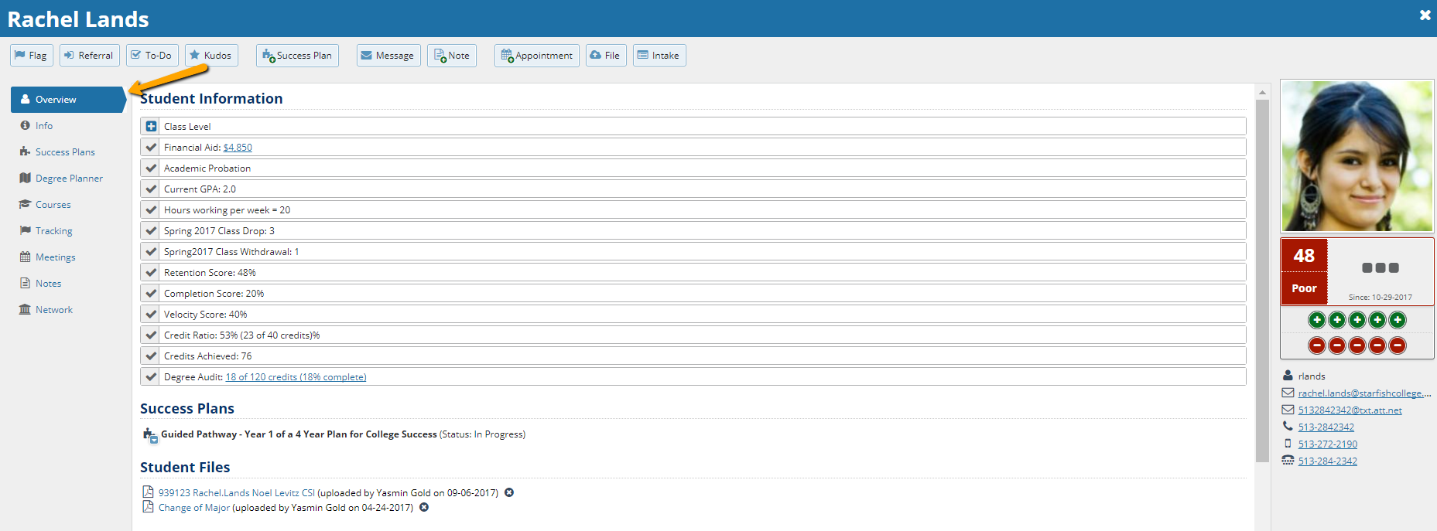
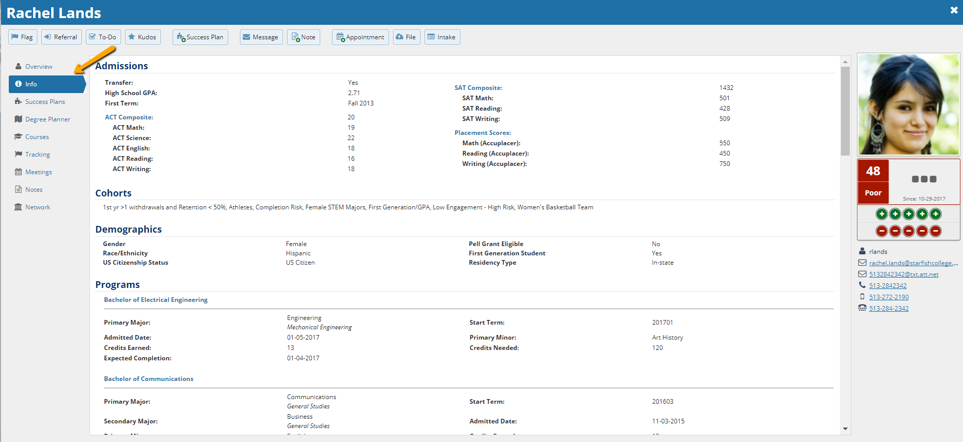
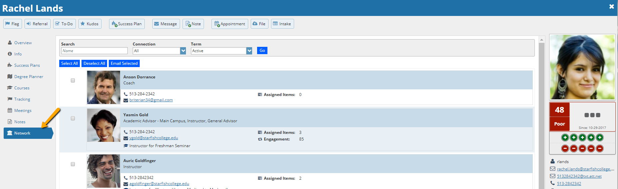
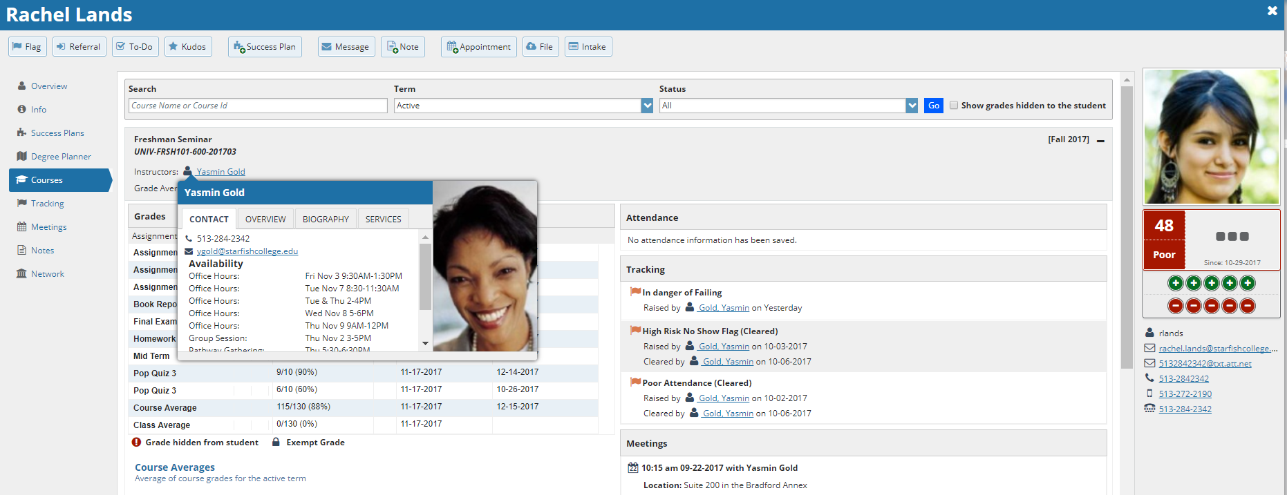
Student Folder
Notes:
Overview: When I click on a student’s name in the list, I am brought to the Overview tab of the student folder where I can see basic information and user attributes.
Info: Data brought in from the SIS shows on the Info tab.
Courses: I can also look at the courses he or she is taking, and any tracking items, appointments or attendance for this course.
Network: The Network tab shows me the people with whom the student has relationships (note that it is configurable to determine which roles can be seen in the success network – so for example a disability counselor may be related to the student, but the system may be configured so that this person does not display to other users of Starfish when reviewing this student’s folder)

Slide 25
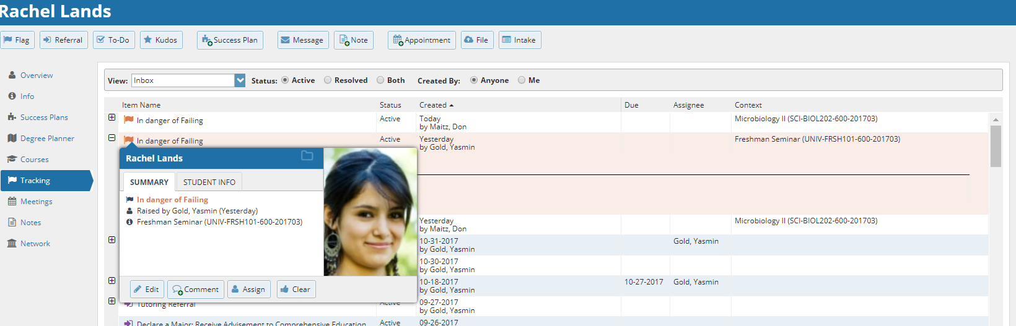
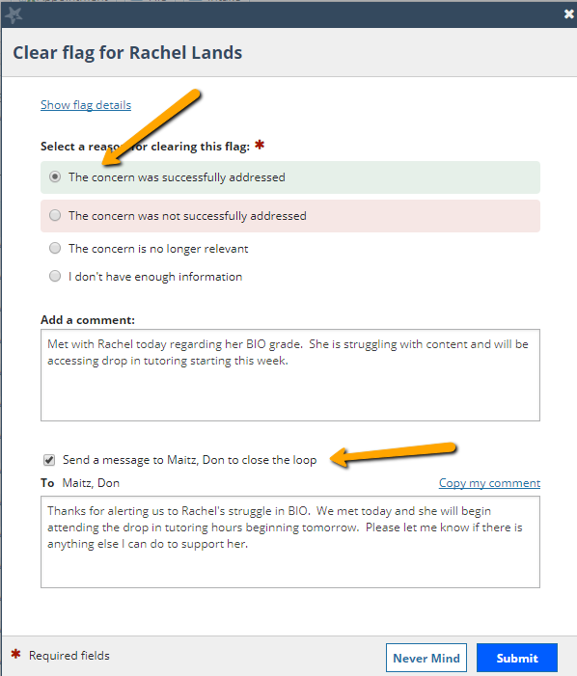
Close The Loop
Notes:
IF the person clearing a flag is not the person who raised it (i.e. the advisor manages the flag to closure after the instructor raised it) he/she will also see the ‘close loop’ dialog, which sends an email back to the raiser to know that the flag has been cleared.
Review your clear reasons and their criteria for use.

Slide 26
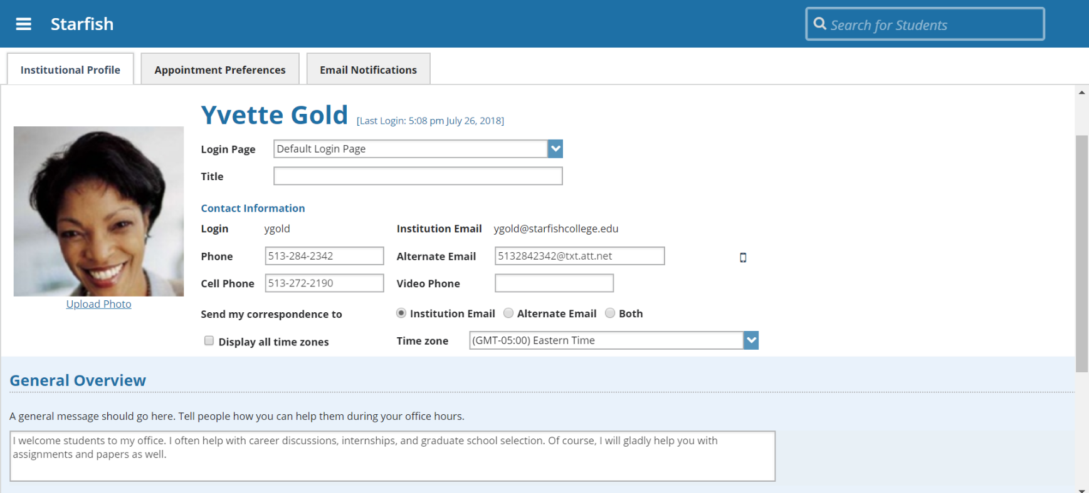
Your Starfish Profile
Notes:
Let’s go ahead and create your Starfish profile.
Some of this information will be filled in from <SIS>, but you have the option to update and further personalize the Profile.
May want to note that if the data is being filled in from <SIS>, changes should be made in <SIS> for any errors/updates – not in Starfish
The general overview message will be shown to students as well as Biography information . Encourage the instructors and advising staff to fill this information in. Students will be more likely to reach out if they know something about their instructor/advisor and can find a personal connection. Similarly, if profile pictures are not automatically integrated, encourage faculty and staff to upload a picture to their profile.

Slide 27
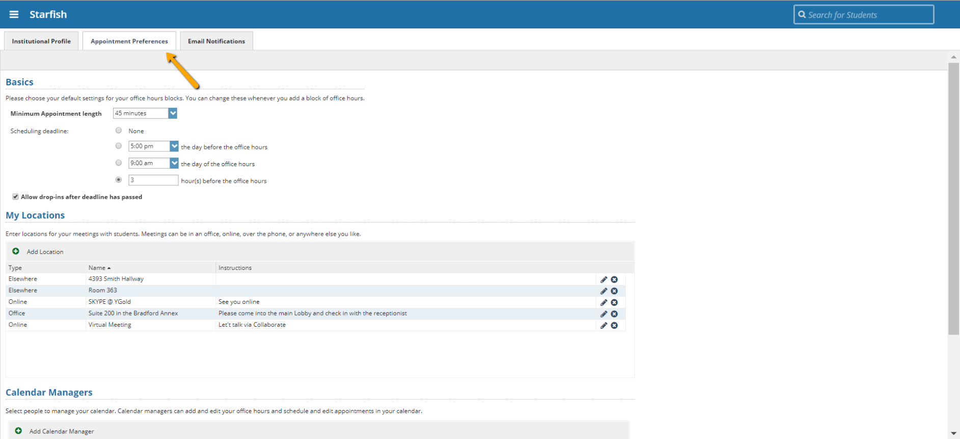
Profile: Appointment Preferences
Notes:
Designate your appointment preferences, location, and calendar managers here. Appointment preferences, in particular Meeting locations must be set up before you will be able to set up any appointments.

Slide 28
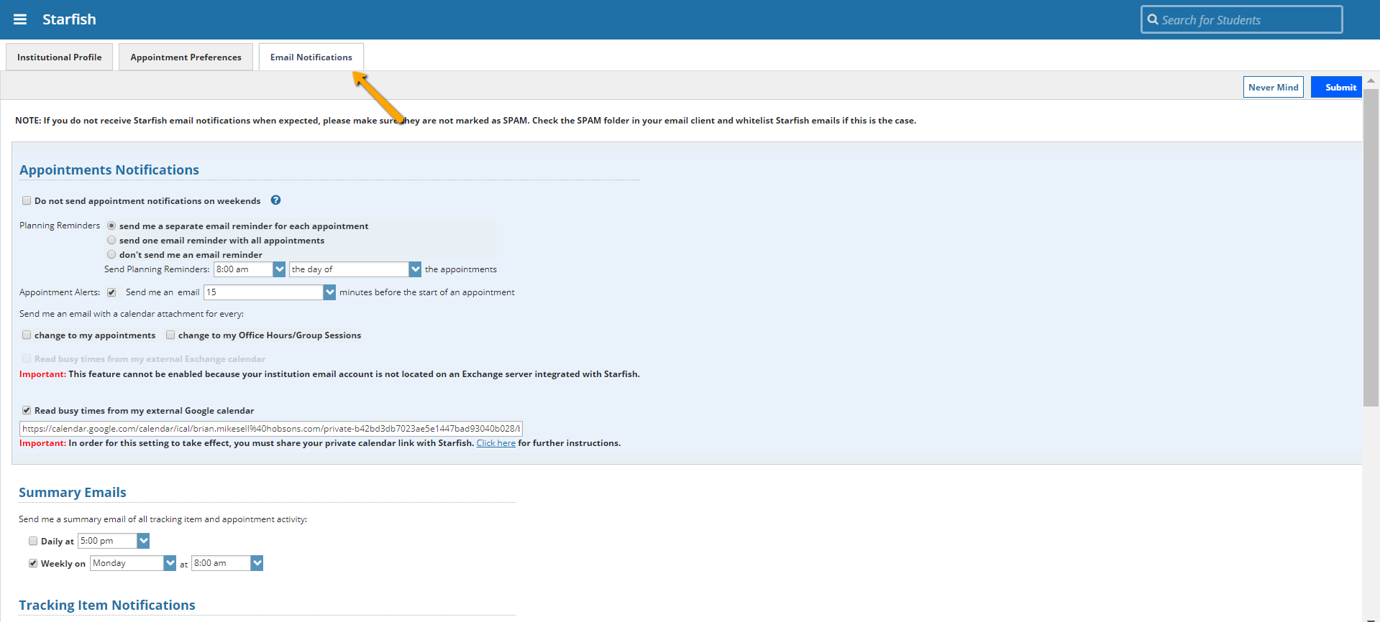
Profile: Email Notifications
Notes:
The email notifications tab within the profile allows the staff member to set preferences for receiving appointment notifications as well as Tracking item notifications. (summary emails)
It’s important to note that Tracking item notifications are based on the configuration established for each individual flag. If for example the flag is set up to send an email to the instructor, and you are the instructor, then these preferences would dictate how frequently you would receive those notifications.
The exception being that if the flag is configured to send ‘emergency notification’ when the flag is raised, that notification will be sent immediately, overriding any preference set here.
The information in the ‘Flag roles’ box will let the user know which flags they would be notified for.
Users may opt to integrate their external calendar into starfish by clicking the provided link and following the steps outlined.

Slide 29
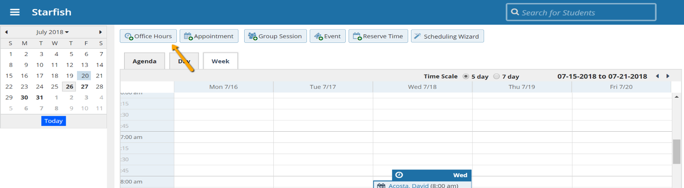
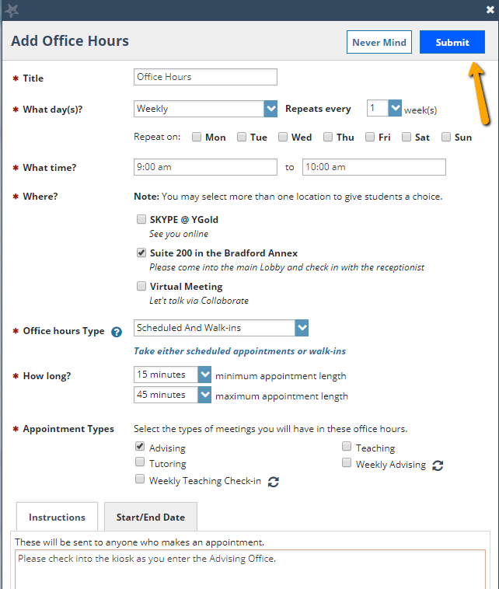
Add Office Hours
Notes:
Complete the Add Office Hours wizard to indicate availability, location, and type of appointment; then click submit. If possible, walk users through this process.

Slide 30
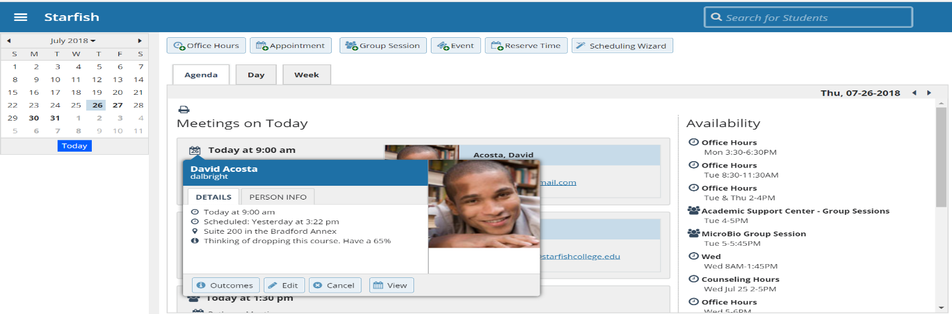
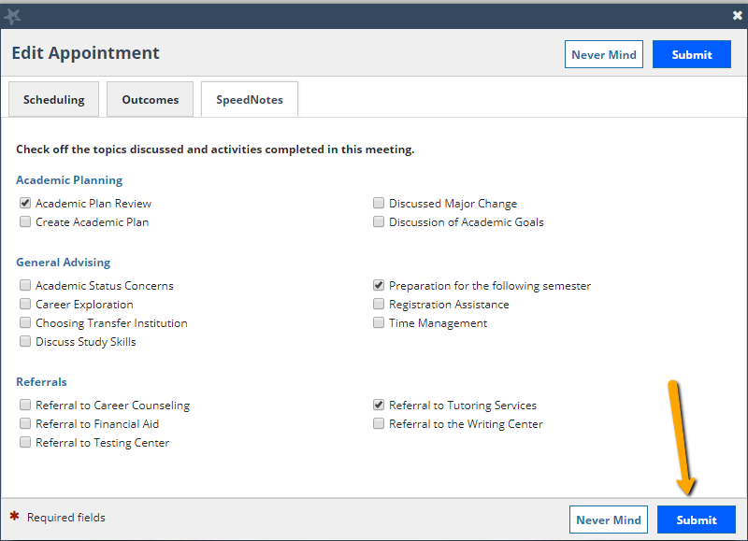
Appointment Outcomes & SpeedNotes
Notes:
Capture your meeting notes by hovering over the appt icon, clicking on “Outcomes”, then selecting the “Speednotes” tab and then select your meeting activities and click submit.

Slide 31
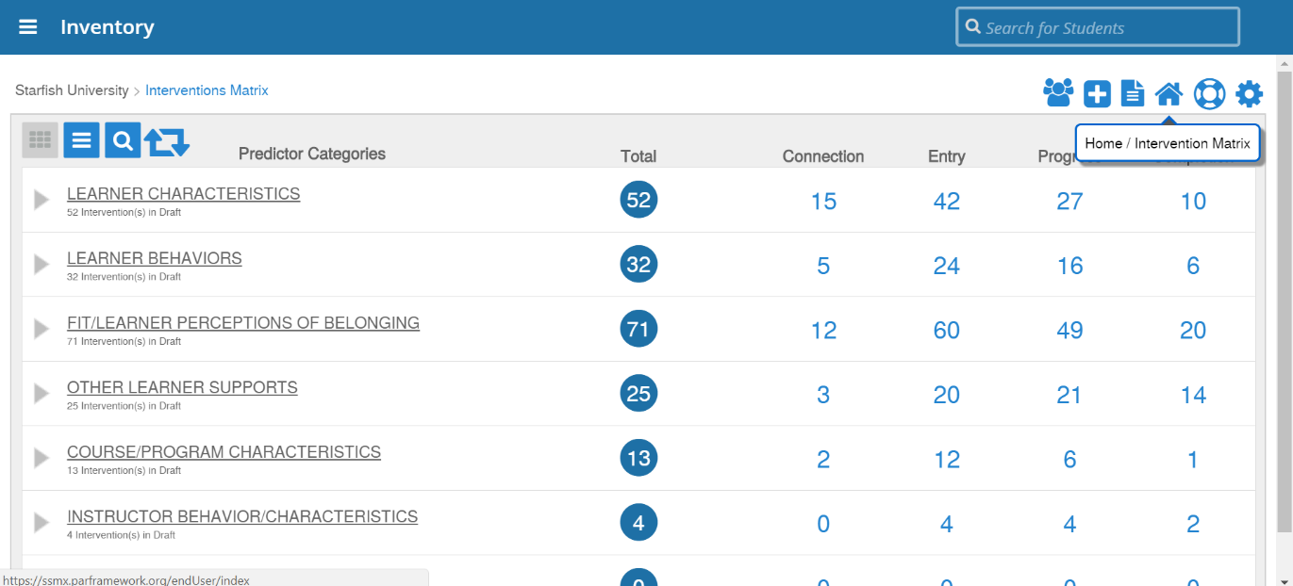
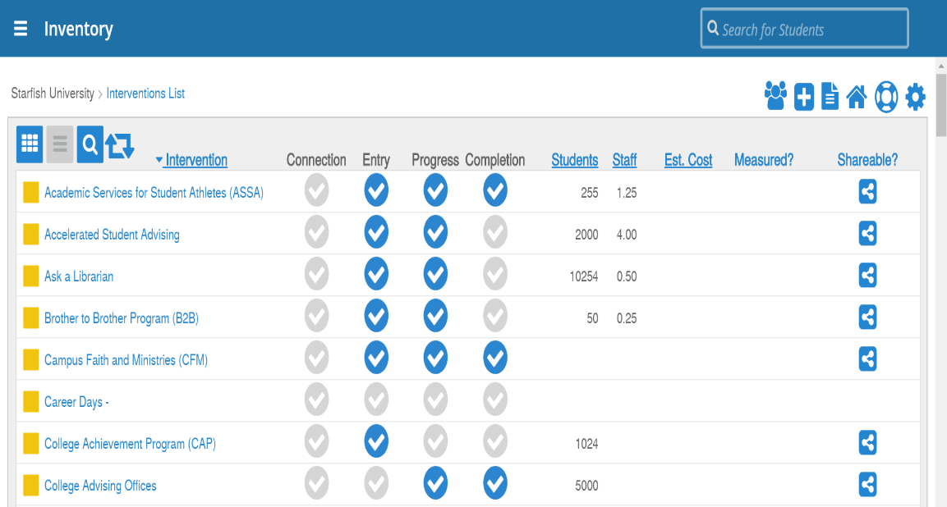
Intervention Inventory
Notes:
The intervention inventory displays the interventions and student supports that are available at your institution. They are displayed in a matrix called the Student Success Matrix which organizes them by predictors of risk and success along the Y axis and academic phases along the X axis.
There is also a list view available shown to the right.

Slide 32

Student View

Slide 33
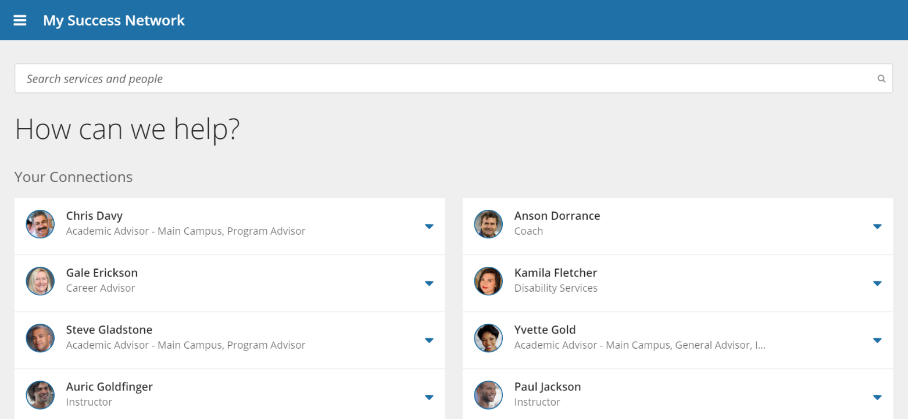
Student View: Homepage / Success Network
Notes:
Walk users through the various sections of the homepage.

Slide 34
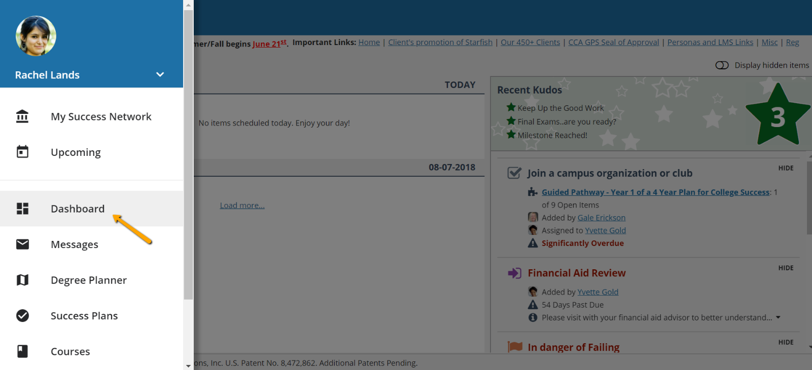
Student View: Dashboard
Notes:
Centralized location for a student to find the individuals that are here to support them (ie-Current Instructors, Advisor, Athletic Coach, etc.)
As configured by your institution.

Slide 35
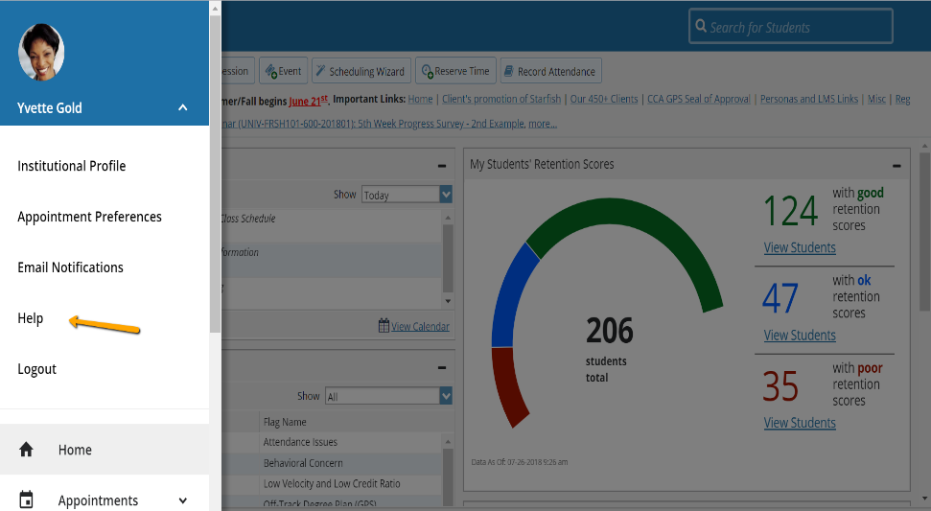
Resources and Support
Institutional Starfish Website: www.starfish@yourschool.edu
System Administrator:
  Contact Name, email address, phone extension
Starfish YouTube channel: https://www.youtube.com/playlist?list=PLrISg2rzQL5bIWqr07FVdPbOZ_Gir_HCx
Notes:
Insert your website address, System Administrator contact information, and any additional resources (print or digital).

Slide 36

Thank you | Questions

