Slide 1
Working with actors in healthcare simulation
Incorporating best practices
Penni Sadlon, MSN/ED, RN, CHSE
Assistant Professor/Simulation Director
Rhode Island College School of Nursing 2018

Slide 2
Association of standardized patient Educators (ASPE)*
Standards of best practice (SOBP)
*The following information is provided by
Lewis, et al. (2017) Association of Standardized Patient Educators Standards of Best Practice. Advances in Simulation, 2 (10), DOI 10.1186/s41077-017-0043-4

Slide 3
Aspe-sobp
Domain 1: safe work environment
Domain 2: case development
Domain 3: training (sp)/actors
Domain 4: program management
Domain 5: professional development

Slide 4
Domain 1 safe work environment: Key concepts
Safe work practices
Confidentiality
respect

Slide 5
Key examples of domain 1: safe work practices
Safe working conditions (psychological safety, breaks, role demand)
Actor screen to assess appropriateness for role
Delineate expectations and clear guidelines
Adverse event planning
De-rolling and debriefing
Sp/actor support

Slide 6
Domain 1: confidentiality
SP/Actors understand confidentiality of all stakeholders
Personal information
Proprietary information
Principles of confidentiality

Slide 7
Domain 1: respect
Respect
Respect for actor self-identified personal/physical boundaries
Provide
Provide enough information for actor to make informed decision to take on role
Define
Define clear protocols of what is/is not included in actor compensation

Slide 8
Domain 2: case development
Preparation
Case components

Slide 9
Domain 2: preparation
Relevant clinical portrayal avoiding stereo-types, bias
Based on real situations
Enough time for development, implementation, pilot, and revision
*Follows *INACSL best practice for simulation objectives and outcomes
INACSL – International Nurses Association for Clinical Simulation and Learning

Slide 10
Domain 2: case components
Case matches level of learners (demonstrated in objectives and outcomes)
Simulation design is “repeatable” and demonstrates overall purpose of simulation
Enough information – back story, history, affect, demeanor, signs and symptoms to simulate, behaviors, attitudes
Case specific feedback for debriefing (how will actors provide feedback?)

Slide 11
Domain 3: Training sps/actors
Preparation for training
Training for role portrayal
Training for completion of assessment instruments (need nursing feedback tool here)
Reflection in the training process

Slide 12
Domain 3: preparation for training
Review materials for training
1
Address actor knowledge gaps
2
Be aware of special instructions
3

Slide 13
Domain 3: training for role portrayal
Review key objectives: learner level, purpose, scope, objectives
Discuss and practice expected role portrayal affects, signs, behaviors
Ensure consistency and accuracy
Assess actor readiness for role portrayal through repeated practice and feedback

Slide 14
Domain 3: training for completion of assessment feedback
Context of feedback
Tools available: (need to create based on expected outcomes)
Subject matter experts (sme’s) can help with this (e.g. professors)
Train actors to deal with unexpected student behaviors (psychological safety and cognitive load)

Slide 15
Domain 3: training for feedback
Review
Review fundamental principles of feedback for level of learner and purpose of simulation (e.g. formative compassionate)
Inform
Inform actors how feedback is given, when, by whom, in what setting
Decide
Decide what process feedback will follow: formal assessment, narrative, checklist, etc.

Slide 16
Domain 3: reflection in the training process
Encourage actor reflection on performance for improvement and quality management
Assist with reflection giving actors an opportunity to debrief and de-role.

Slide 17
Domain 4: program management
Refer to INACSL standard on professional integrity
Purpose
Expertise
Policies and procedures
Records management
Team management
Quality management

Slide 18
Domain 4: purpose
Develop a mission statement
Develop program goals
Develop measurable objective for each goal

Slide 19
Domain 4: expertise
Possess
Possess depth of knowledge of sps and actors in simulation
Advocate
Advocate for the integration of sp/actor simulation methodology
Identify
Identify when an sp or actor is appropriate for a simulation activity
Collaborate
Collaborate with subject matter experts (SME’s) in case design, training and assessments
Train
Train actors according to project parameters

Slide 20
Domain 4: policies and procedures
coordinate efforts with leadership team (RICSON/RINEC collaboration)
Develop and document policies to guide program activities
Develop policies that are inclusive and consider disability access
Develop policies of administration (business and strategic planning)
Records management: develop a system for recording keeping, evaluations, outcomes, recording data, privacy, consent forms, release forms (e.g. our cae systems)
*Specific to RICSON simulation program goals
coordinate efforts with leadership team (RICSON/RINEC collaboration)

Slide 21
Domain 4: team management**
**Consult with legal and human resource management for actor employment status, (independent contractor), and have agreement among all constituents.
**develop processes to screen, interview, select, debrief and maintain sp and Actor list.
Advocate for ongoing development of actor staff.
**Specific to RICSON/RINEC Memorandum of Understanding

Slide 22
Domain 4: quality management**
Gather data regularly to assess alignment of program activities with legislated, institutional and program accreditation policies and procedures.
Gather feedback from all involved stakeholders (faculty, students, actors, leadership)
Analyze data regularly
Provide a process for continuous improvement and communication of improvement changes.
**Specific to RICSON/RINEC Memorandum of Understanding

Slide 23
Domain 5: practice
Career development
Scholarship
leadership

Slide 24
Domain 5: career development
Develop and promote
Develop and promote expertise in knowledge, skills, and attitudes in sp/actor-based simulation
Develop and promote
Develop and promote expertise in theories, principles, and processes of education and assessment relevant to the context of nursing practice.
Maintain
Maintain membership in professional simulation organizations (ASPE, INACSL, SSiH, etc)
Encourage
Encourage educational opportunities (conferences, workshops)
Develop
Develop personal management skills (time management, wellness strategies, career planning)
Seek out
Seek out career mentoring

Slide 25
Domain 5: scholarship
Understand
Understand scholarly opportunities in sp/actor methodology
Identify
Identify and/or develop new contexts for sp/actor methodology
Contribute
Contribute to the advancement of best practices through innovation, research, and dissemination (publications, presentations)

Slide 26
Domain 5: Leadership
Promote understanding and development of sp/actor methodology locally, nationally, and internationally
1
Support and mentor other sp/actor educators and trainers within one’s institution and the community of practice.
2
Seek out and advocate for growth of leadership skills (collaboration, team building, change management, interpersonal effectiveness, conflict resolution).
3

Slide 27
resources
International nurses association for clinical simulation and learning (INACSL) at: inacsl.org
The Society for simulation in healthcare (ssih) at ssih.org
Association of standardized patient educators (ASPE) at ASPEducators.org

Slide 28
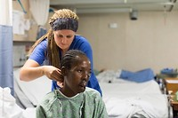
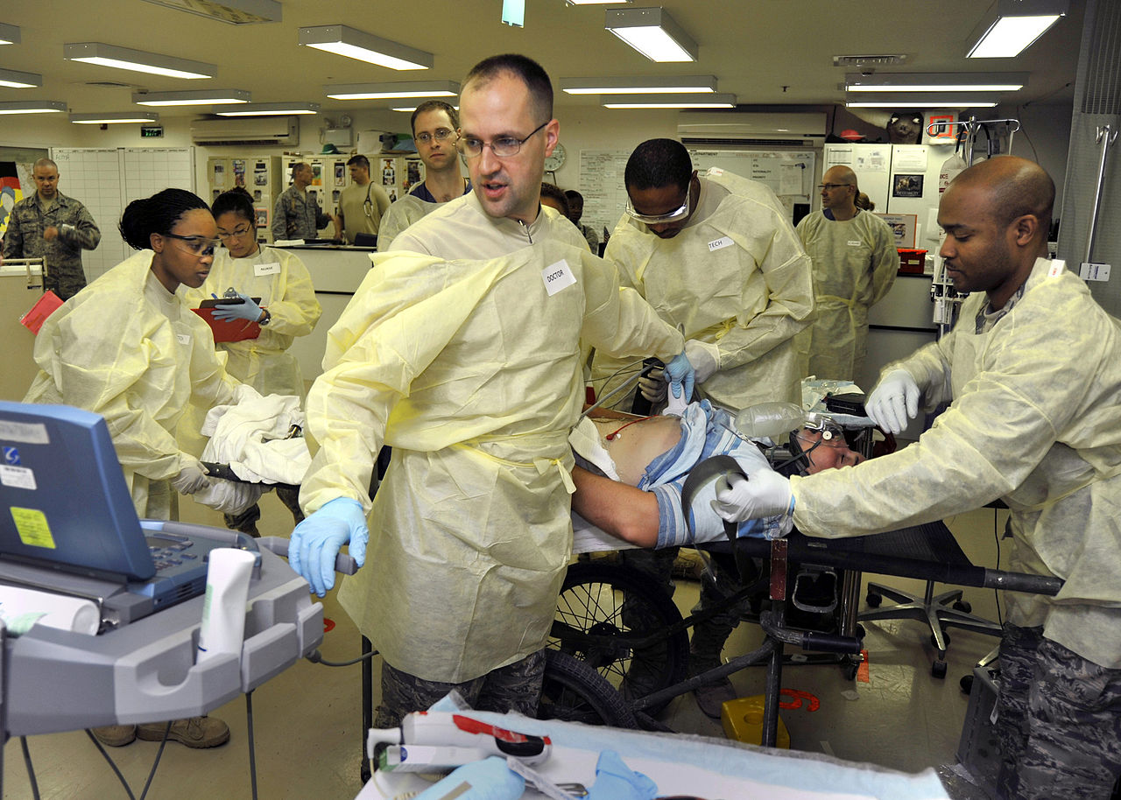
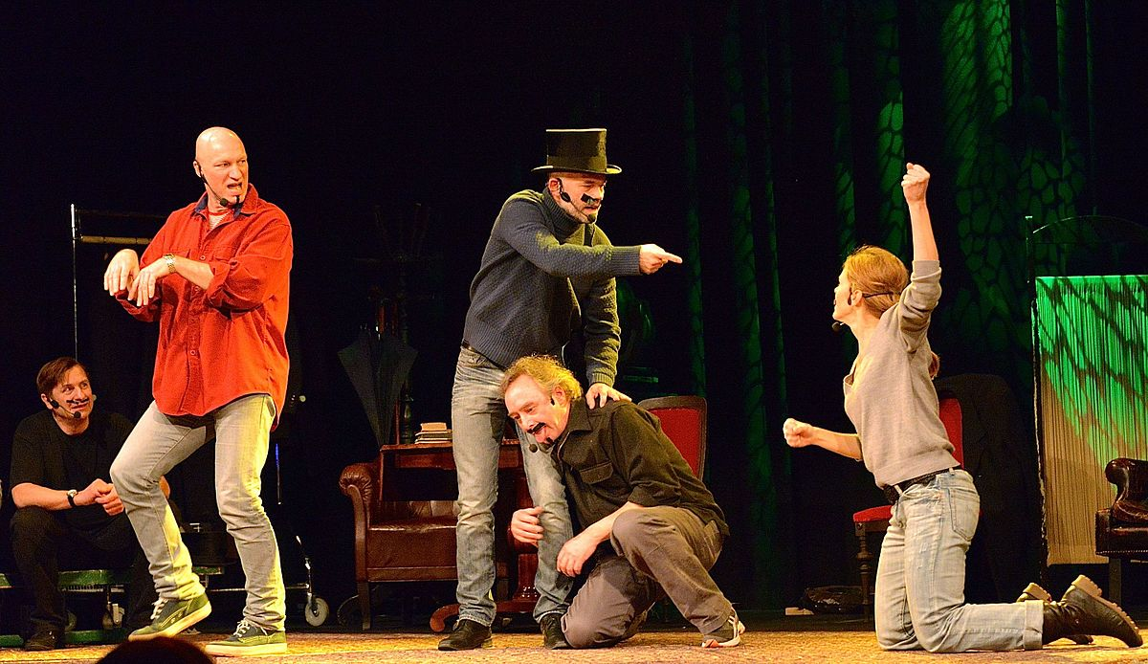
THANK YOU FOR YOUR ATTENTION!
Photos from creative commons
Presentation of working with actors in HEALTH CARE simulation 2018 Sadlon

